Slide 1
FUNCTIONS 1 Notation and Types of Functions
IB 1

Slide 2

The idea of functions is not new to us. For example we have used y = 4x – 3 this can be written as a function f(x) = 4x – 3 or f: x $→$4x – 3

Slide 3

TYPES OF RELATIONS
ONE TO ONE Y = X
ONE TO MANY Y = $√X$ or ………………..
MANY TO ONE Y = $X^{2}$ or …………………….

Slide 4
But first….
A relation can be defined as an identifiable pattern between two variables or a set of ordered pair.
A FUNCTION IS A SPECIAL TYPE OF A RELATION

Slide 5
A relation can only be a function if …
It’s one to one or a many to one
Each x ‘object’ has only one y ‘image’
How do we know if a relation is a function?
Through
Graph
Equation
Ordered pairs
Table of values
Mapping diagrams
Function machines

Slide 6
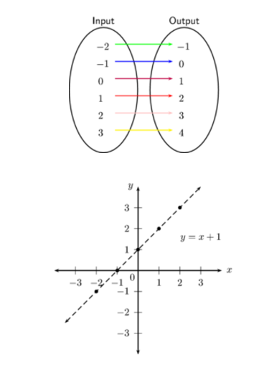
One to one function

Slide 7
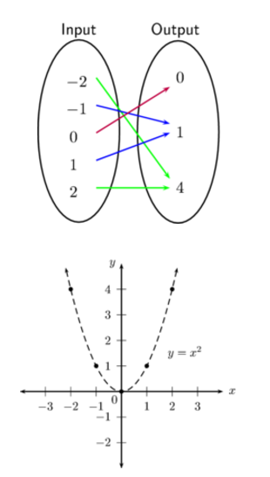
Many to one functions

Slide 8
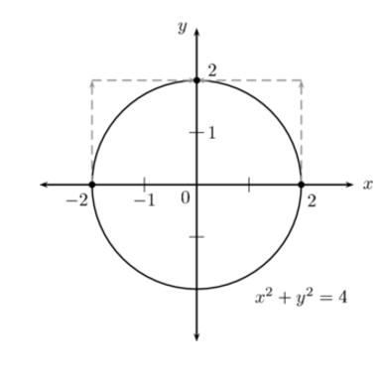
Not a function

Slide 9
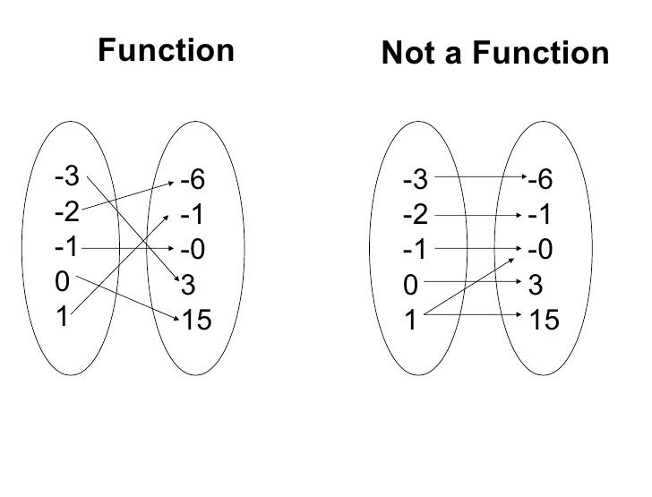

Slide 10
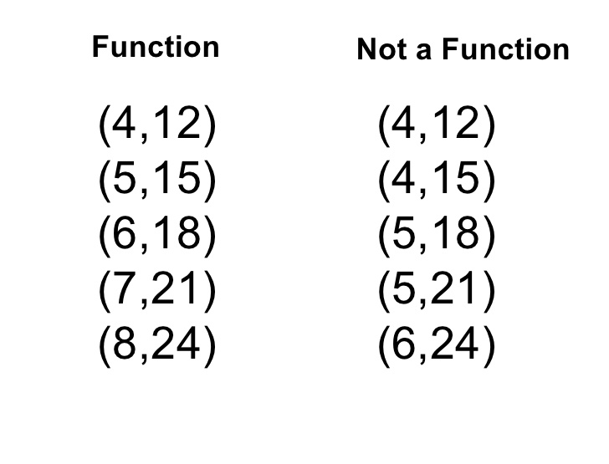

Slide 11
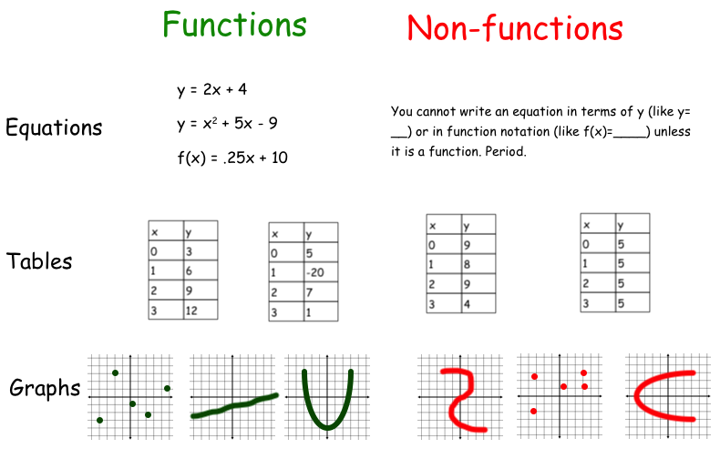

Slide 12
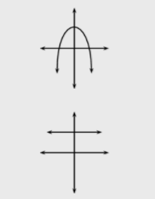
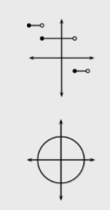
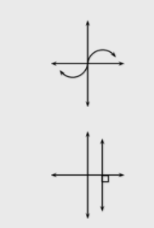
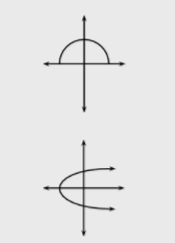
Function or not a function?

Slide 13
Questions to Try
Page 18
Page 21

Slide 14
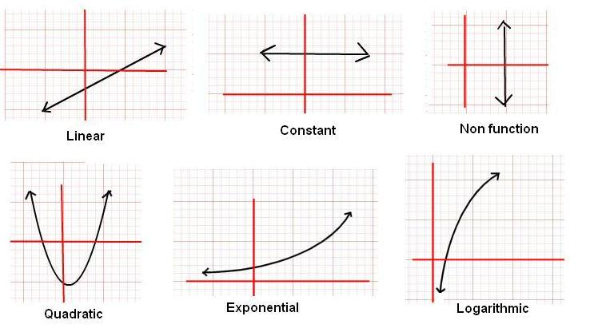
Types of functions

Slide 15
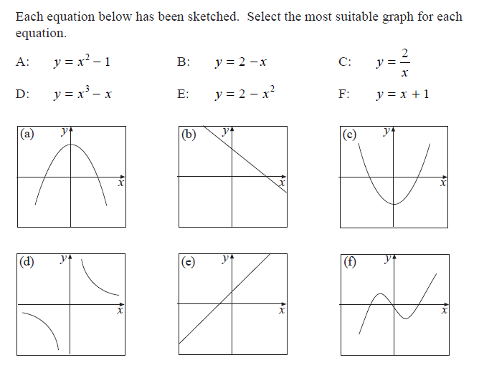

Slide 16
Value of a function and composite functions
If f(x) = 5x + 6 find f(2); f(-1); f(0) and f(10)
If g(x) = 20 – 4x find f(2x) leaving your answer in terms of x
If f(x) = 1+ 2x and g(x) = 3x + 9 find (f o g) (8)

Slide 17

Composite Function
Given that f: x $→ x^{2}+1$ and g: x $→3 −x$ find in its simplest form
[a] (f o g) (x)
[b] (g o f) (x)
[c] x if (g o f) (x) = f(x)

Slide 18
The reciprocal function
What are the key points to look out for?
IMAN
I for……………………………………………..
M for……………………………………………..
A for……………………………………………..
N for……………………………………………..

Slide 19
Complete all exercises up to 1E

